Slide 1
DATA ANALYSIS AND VISUALIZATION
By
Joseph Chibuike Nwokeafor

Slide 2

Long-term goal
Build an Interactive platform for visualizing and analyzing data generated by sensors
Notes:
The long-term goal of the project is to develop a platform for interactive visualization and analysis of data collected from a wide array of sensors, from sensors that monitor environmental parameters such as temperature to industrial and healthcare sensors, and IOT devices. So, this project is just a baby step into the bigger project.

Slide 3
Major applications
Analyze trends and patterns
Anomaly detection
Real-time data monitoring
Notes:
Anomaly detection especially in time series analysis.

Slide 4
Comparing the two classes IN MY IMPLEMENTATION
SalesDataAnalysis
Importance
GUIApp
Difficulty

Slide 5
Comparing the INDIVIDUAL methods and functions
clean_data( )
Importance
corr_matrix( )
plot_chart( )
summary_statistics( )
clear_output( )
conditional_formatting( )
Difficulty

Slide 6
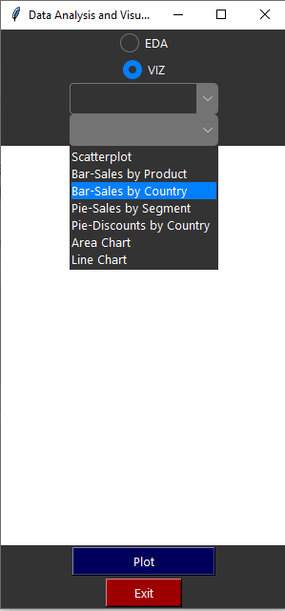
SCREENSHOTS OF TKINTER GUI

Slide 7
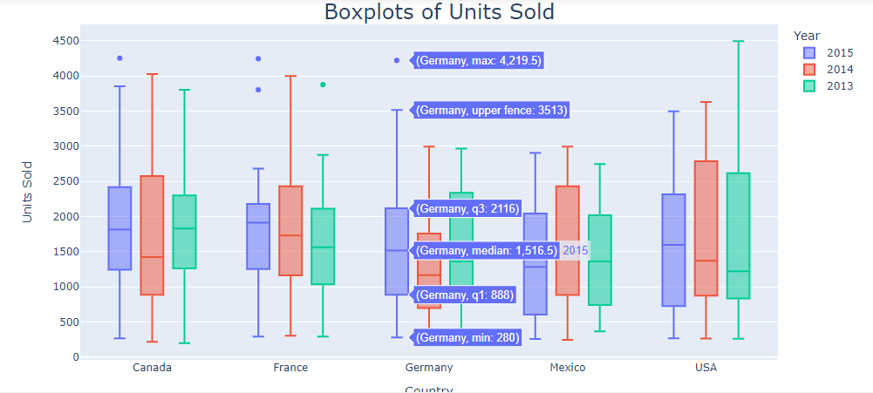
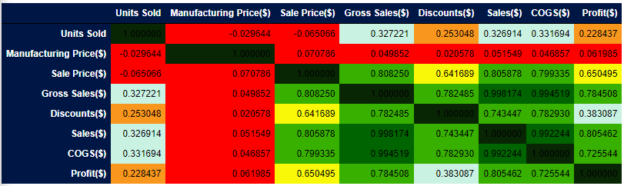
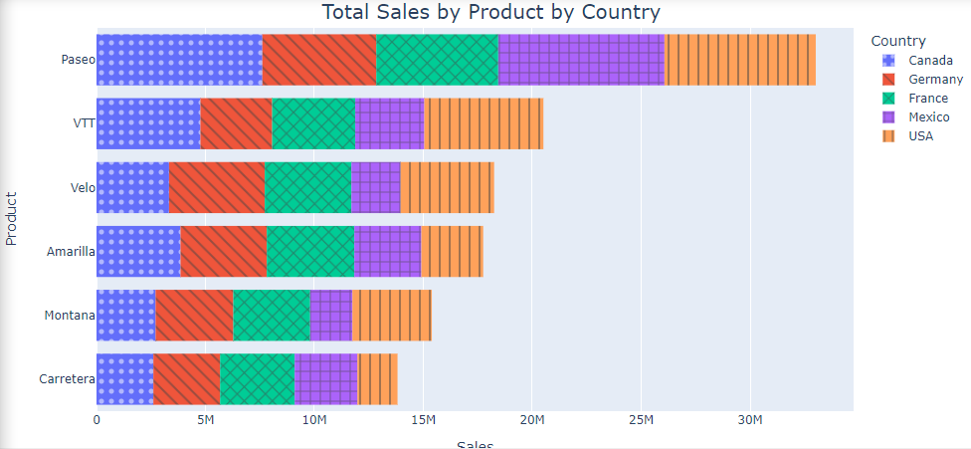
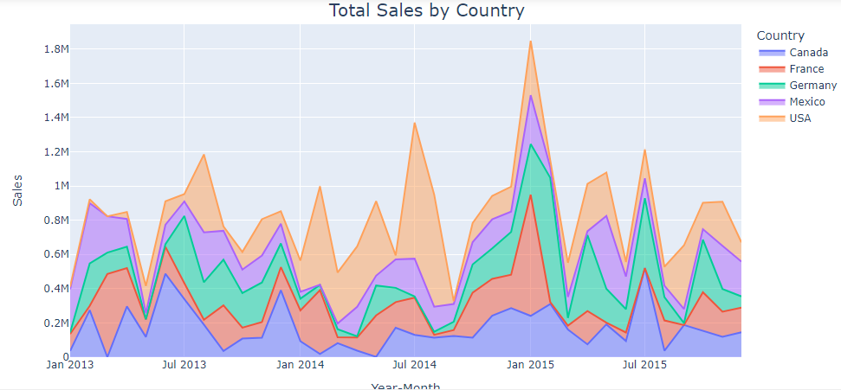
SCREENSHOTS OF SOME OUTPUTS

Slide 8
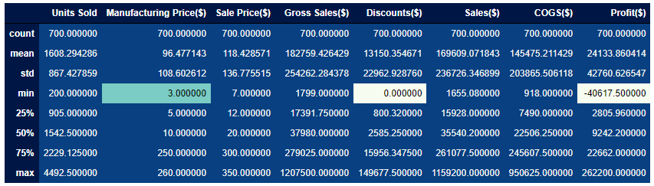
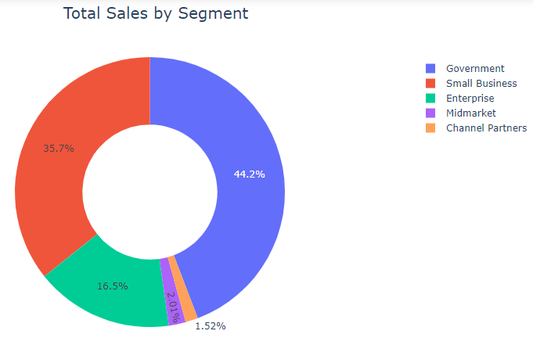
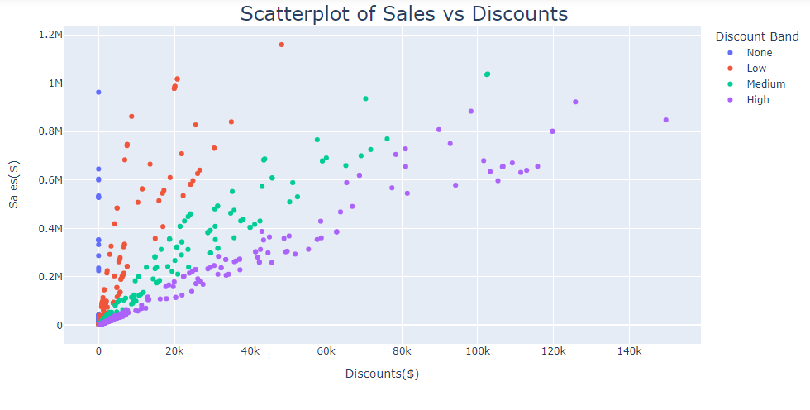
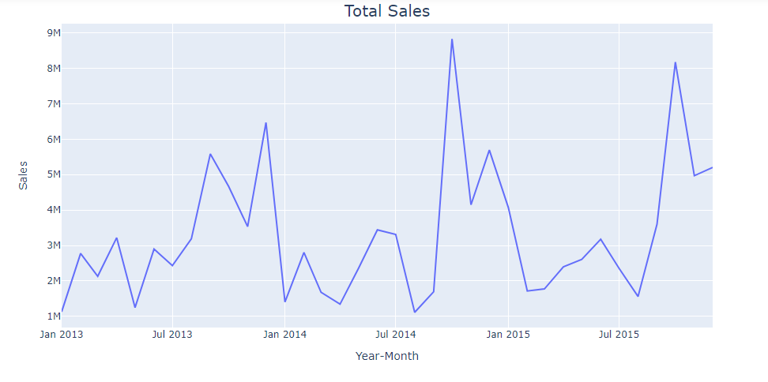
MORE SCREENSHOTS OF OUTPUTS

Slide 9
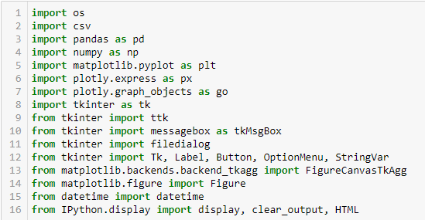
SCREENSHOT OF PACKAGES AND MODULES USED

Slide 10
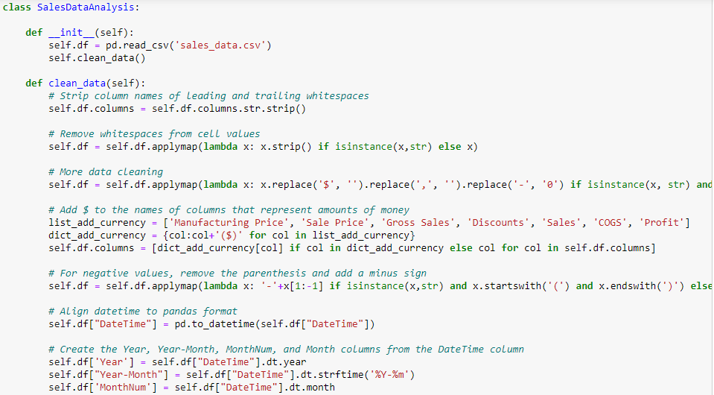
SOME CODE SNIPPETS

Slide 11
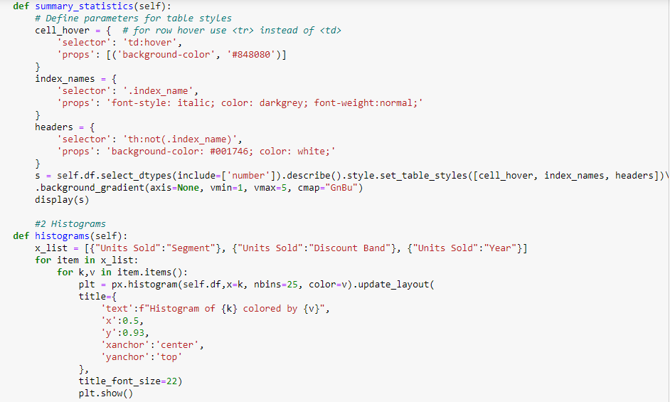
MORE CODE SNIPPETS

Slide 12
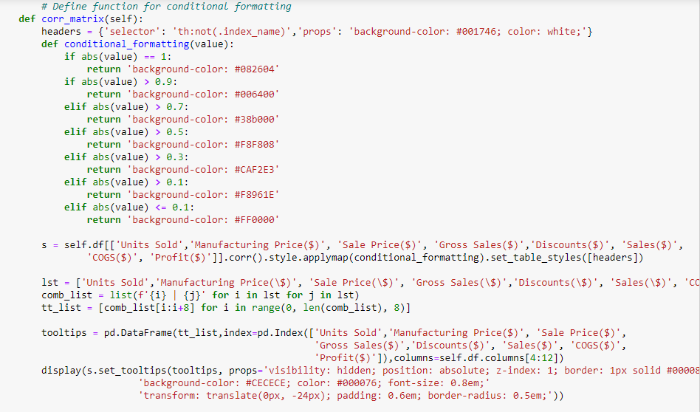
MORE CODE SNIPPETS

Slide 13
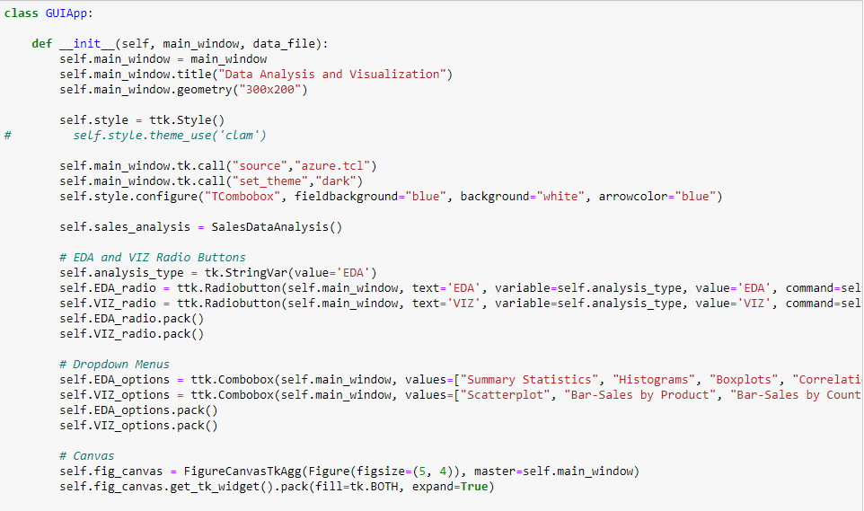
MORE CODE SNIPPETS

Slide 14
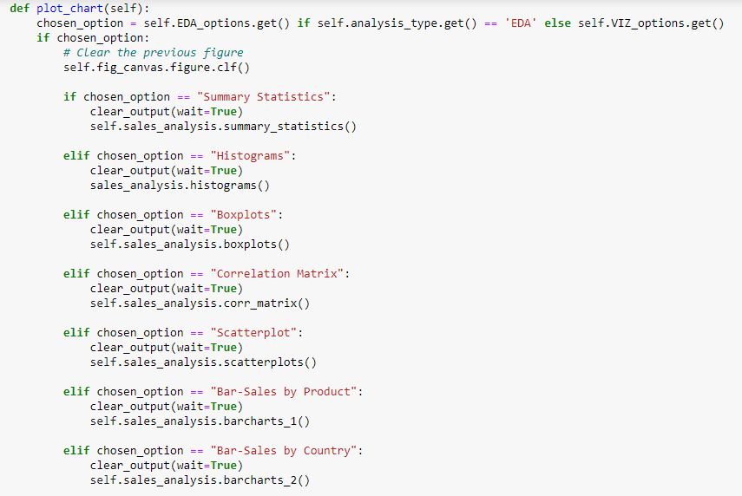
MORE CODE SNIPPETS

Slide 15
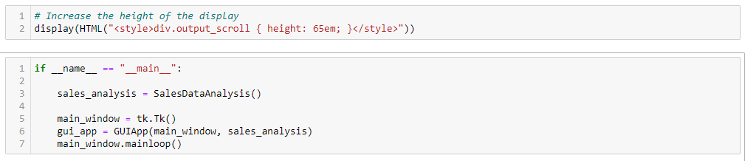
MORE CODE SNIPPETS

Slide 16
DEMO

Slide 17


Slide 18
REFERENCES
Pandas documentation — pandas 2.1.4 documentation. (n.d.). https://pandas.pydata.org/docs/
Plotly. (n.d.). https://plotly.com/python
Matplotlib — Visualization with Python. (n.d.). https://matplotlib.org/
Graph. (n.d.). https://plotly.com/python/graph-objects/
Python Tutorial. (2023, December 3). GeeksforGeeks. https://www.geeksforgeeks.org/python-programming-language/

